Slide 1
Use Matlab to Simulate ultrasound circuit flow
指導教授：董蘭榮 教授
研 究 生：林柏佑

Slide 2
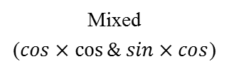
Use Matlab to simulate ultrasound flow
Reflect from body
Mixed
($cos×\cos{\& sin×cos}$)
Ultrasound transmit sine signal
Receive signal
Arctangent
Low pass filter
Get heart signal

Slide 3
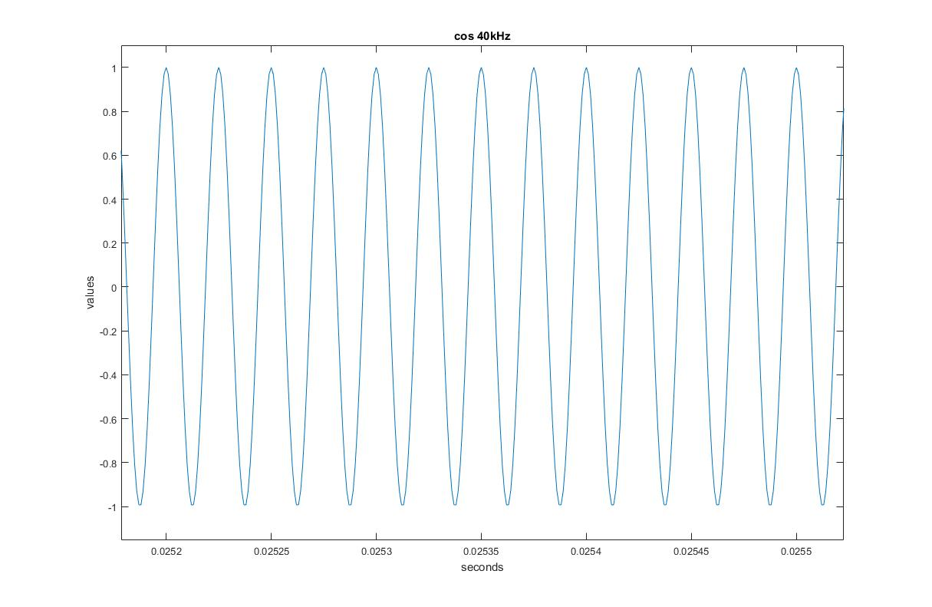
40kHz cos signal

Slide 4
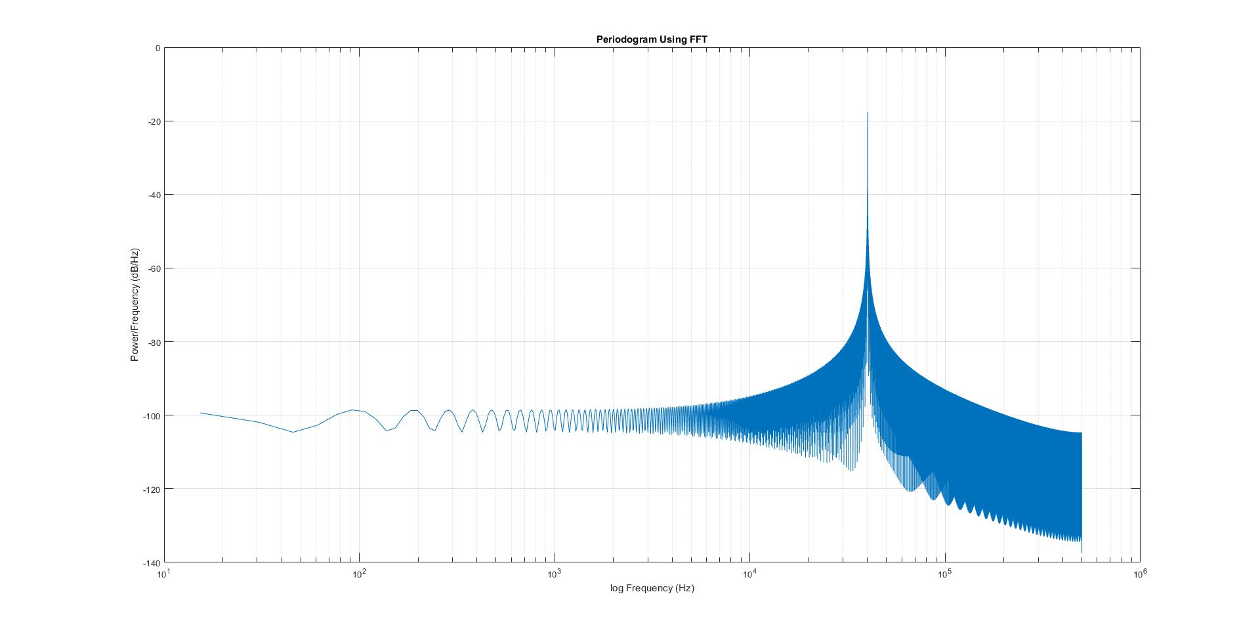
Cos signal after FFT

Slide 5
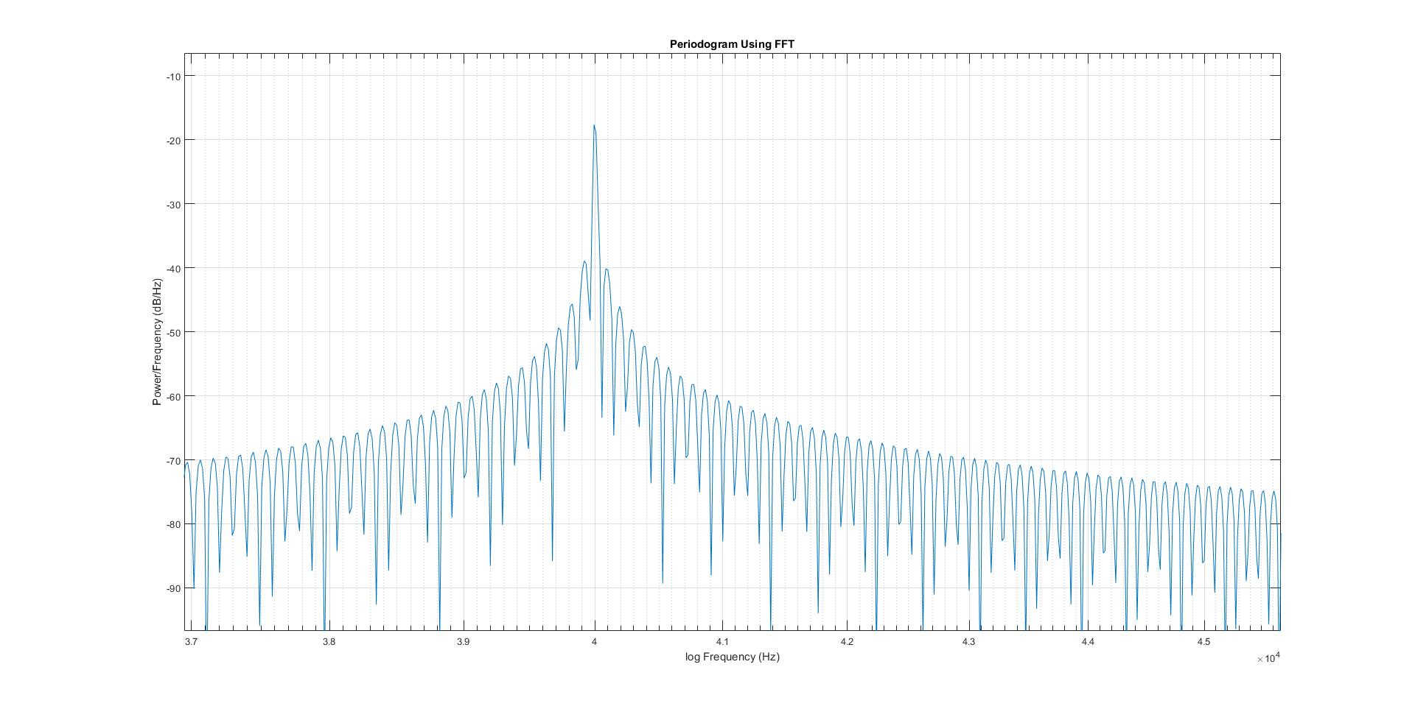
Cos signal after FFT(zoom in)

Slide 6
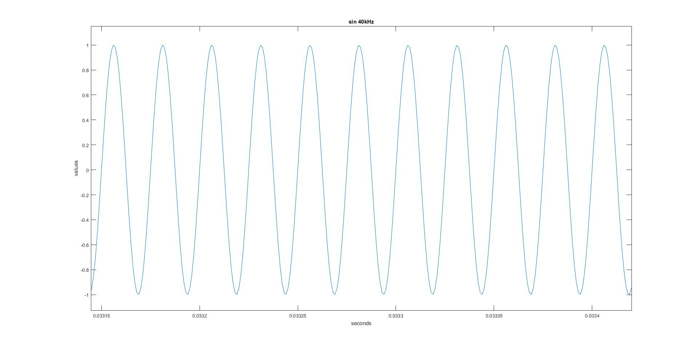
40kHz sin signal

Slide 7
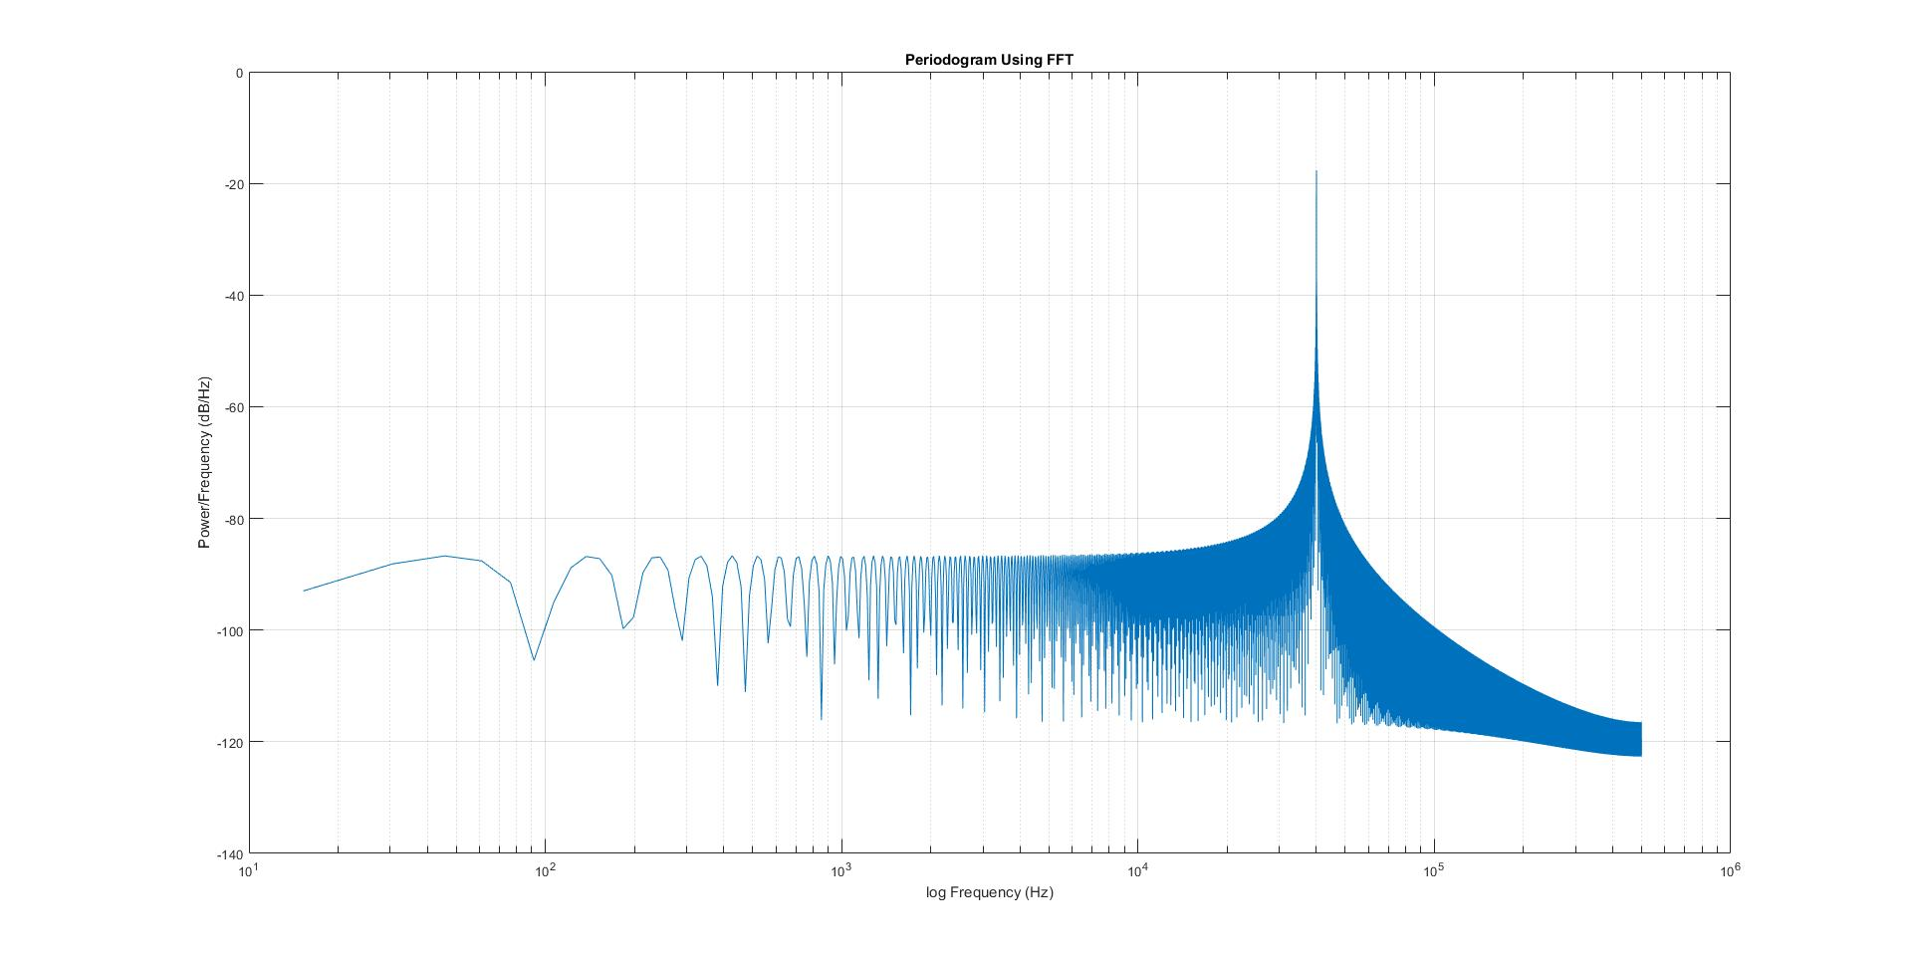
Sin signal after FFT

Slide 8
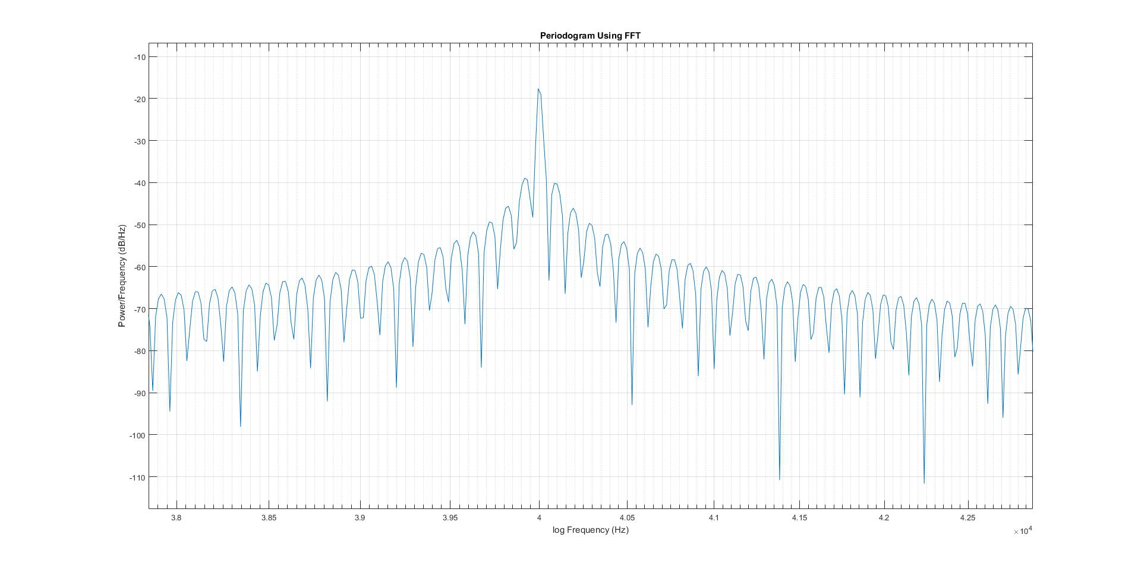
Sin signal after FFT(zoom in)

Slide 9
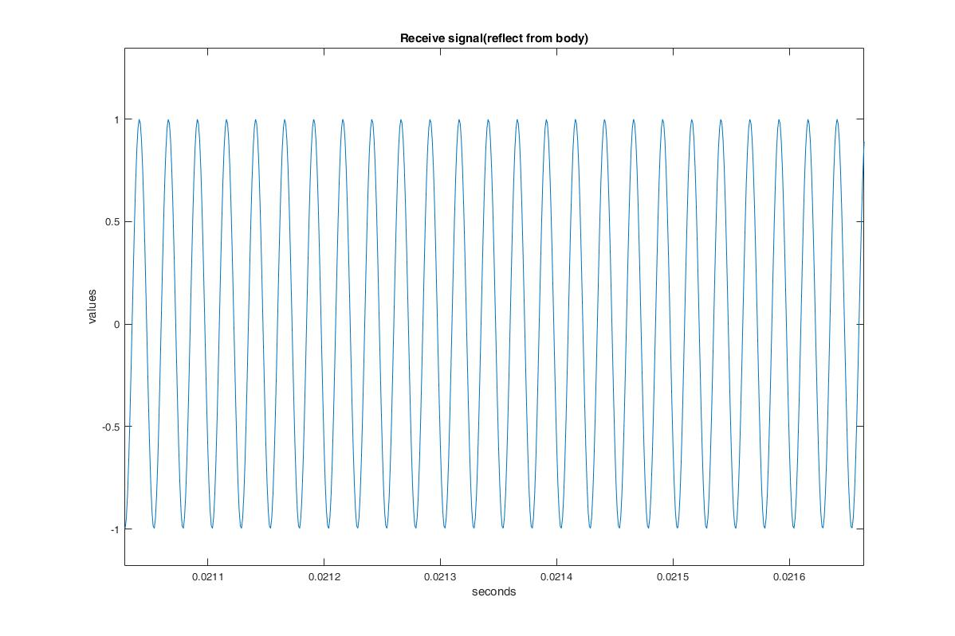
Receive signal(reflect from body)

Slide 10
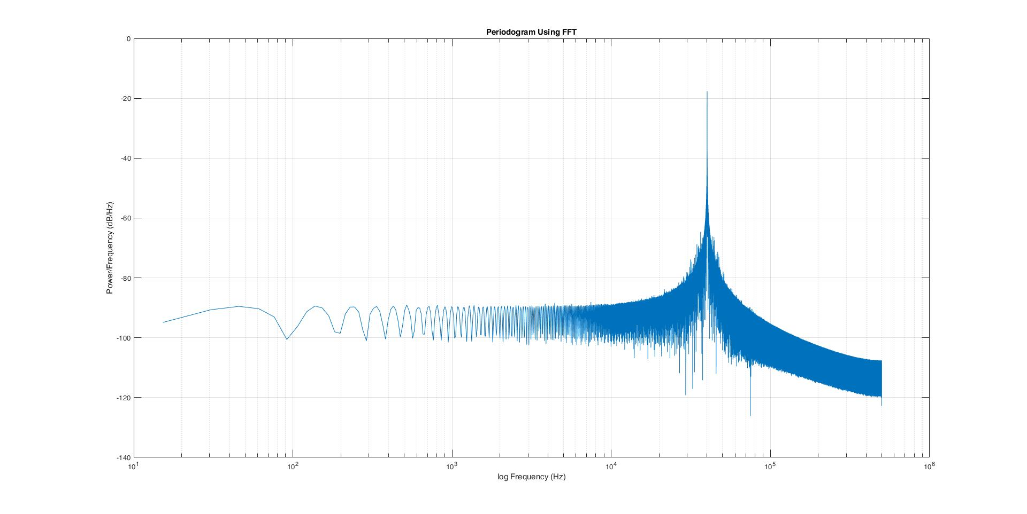
Receive signal(after fft)

Slide 11
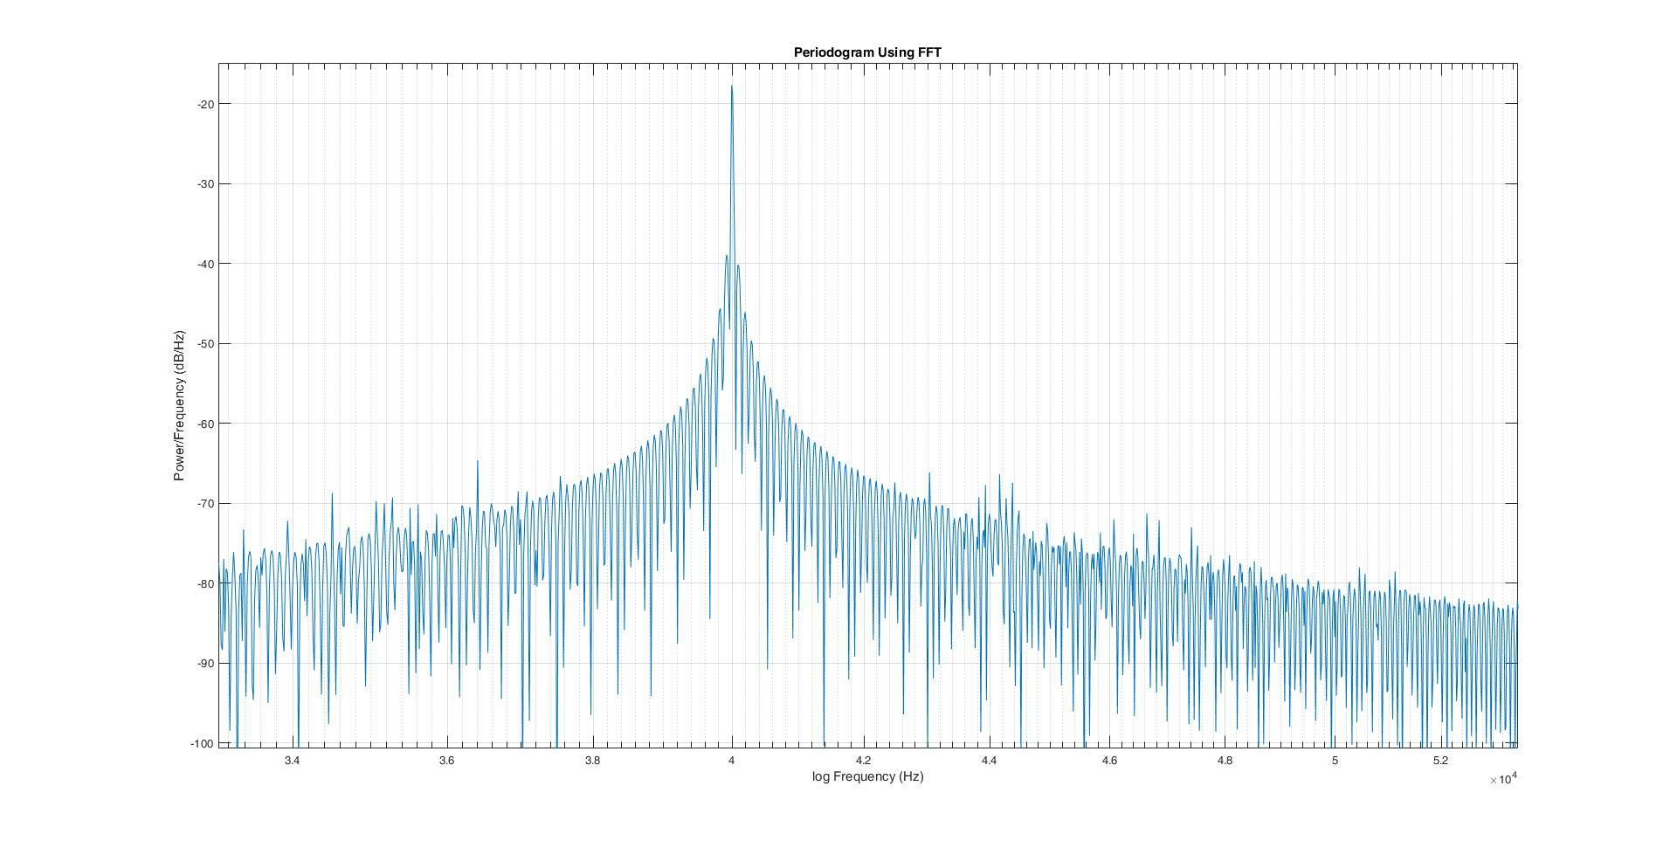
Receive signal(after fft(zoom in))

Slide 12
Receive signal(after fft(zoom in))

Slide 13
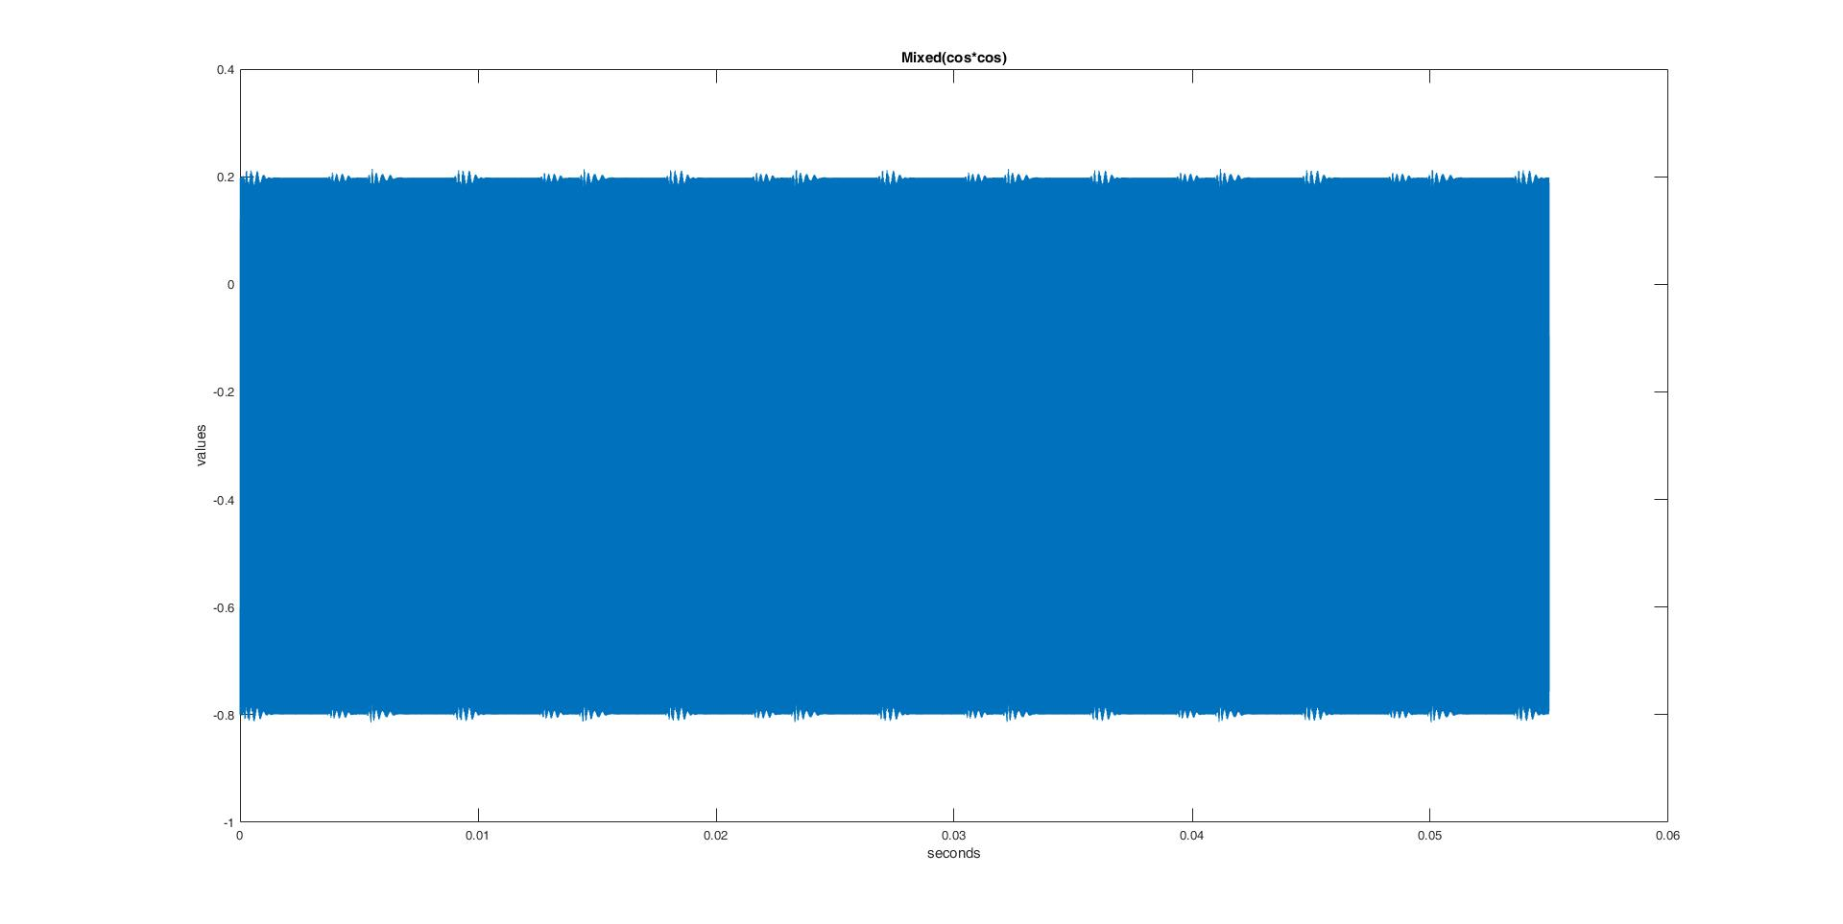

Mixed($cos×cos$)

Slide 14
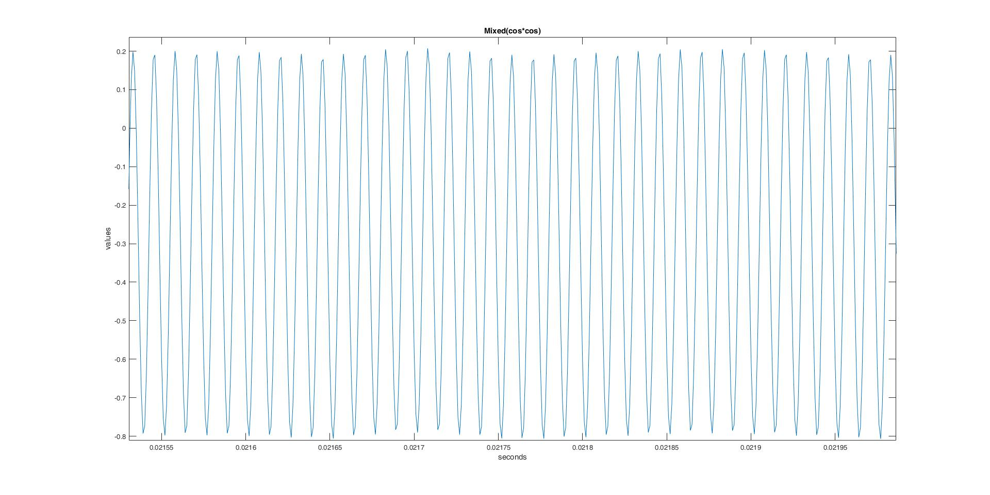

Mixed($cos×cos$) zoom in

Slide 15
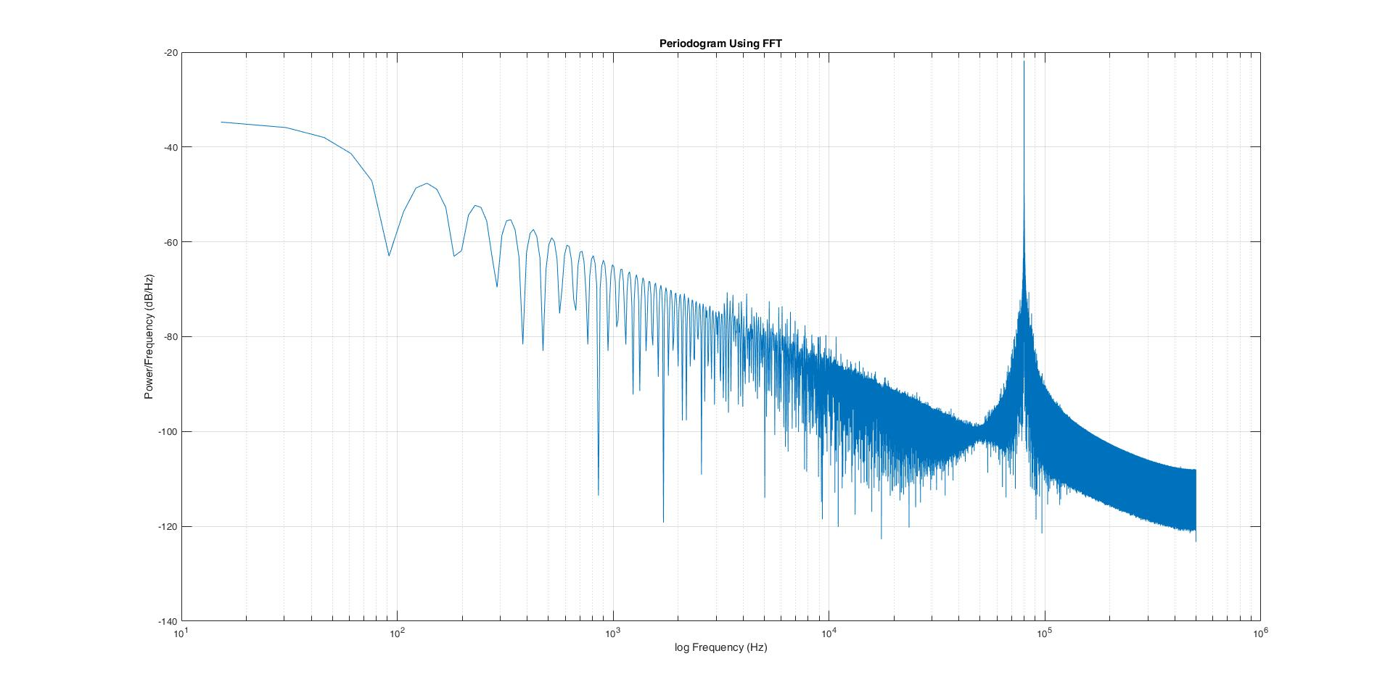

Mixed($cos×cos$) after FFT

Slide 16
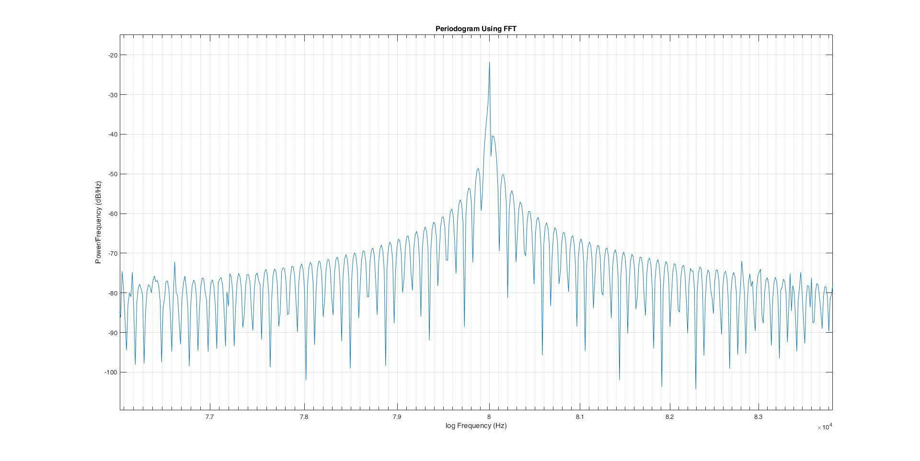

Mixed($cos×cos$) after FFT zoom in

Slide 17
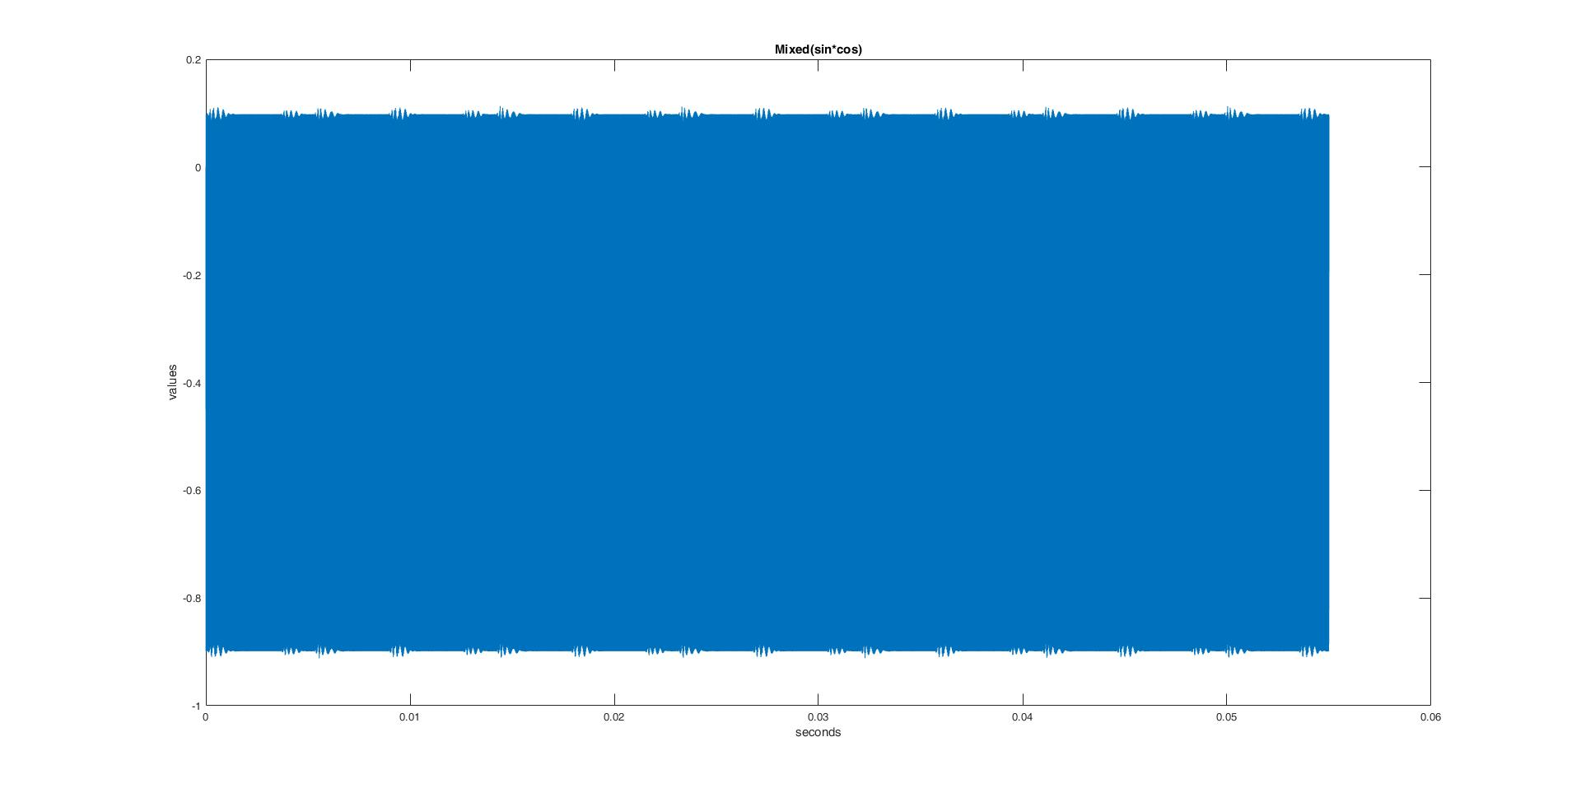

Mixed($sin×cos$)

Slide 18
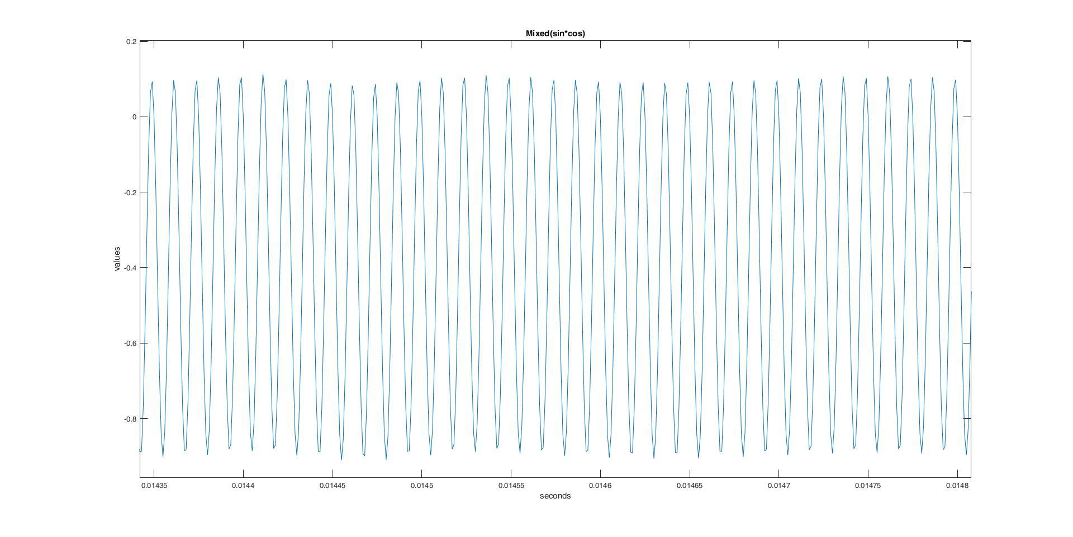

Mixed($sin×cos$) zoom in

Slide 19
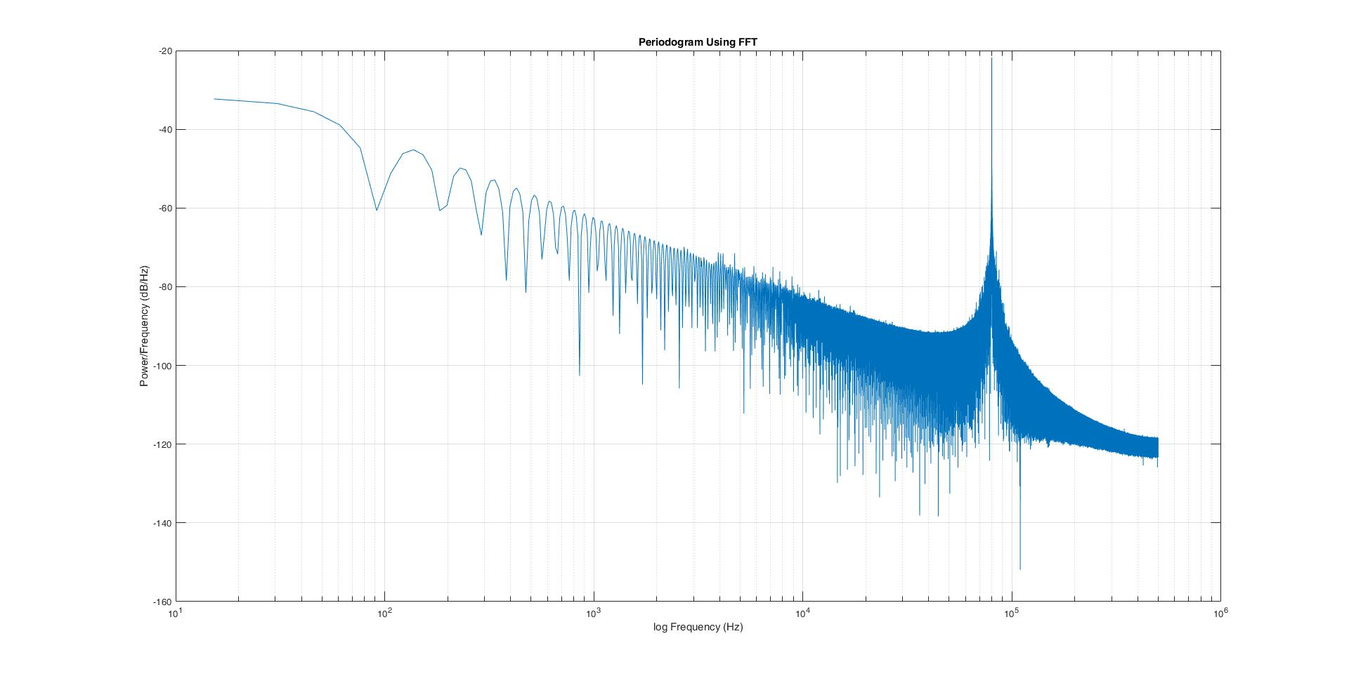

Mixed($sin×cos$) after FFT

Slide 20
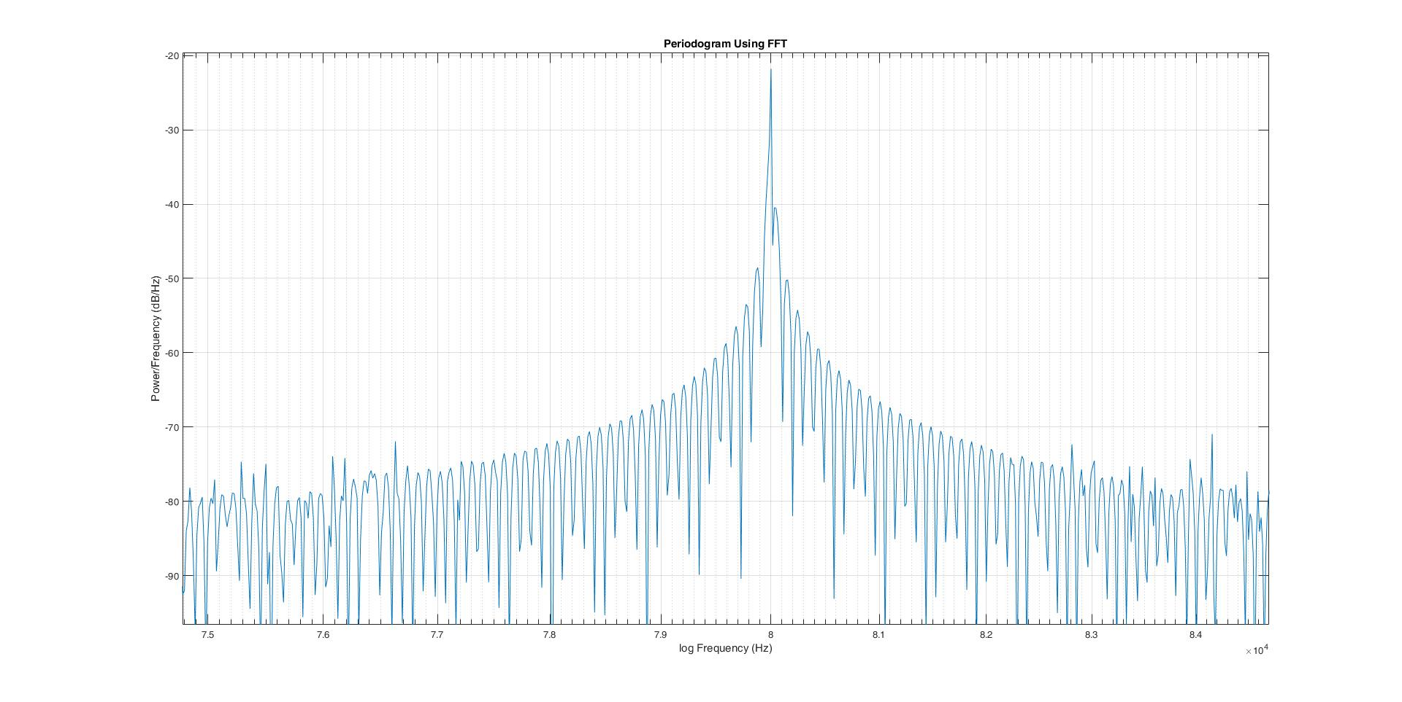

Mixed($sin×cos$) after FFT zoom in

Slide 21
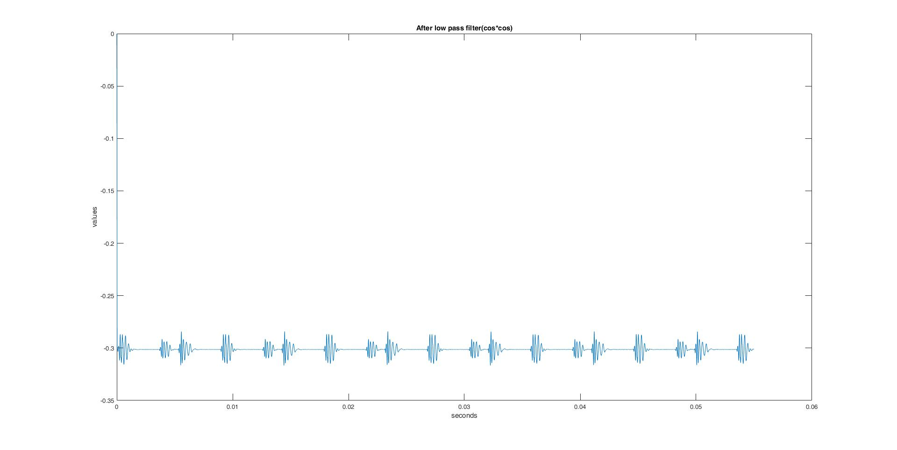

After low pass filter ($cos×cos$)

Slide 22
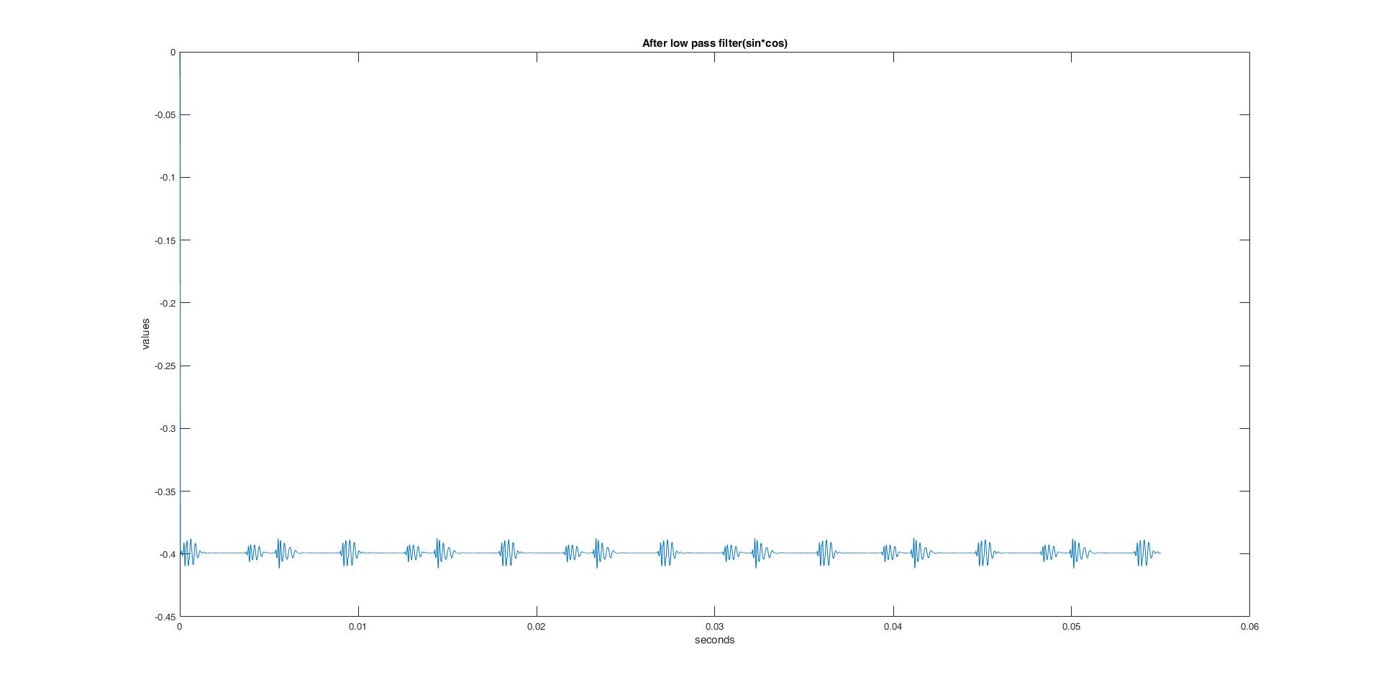

After low pass filter ($sin×cos$)

Slide 23
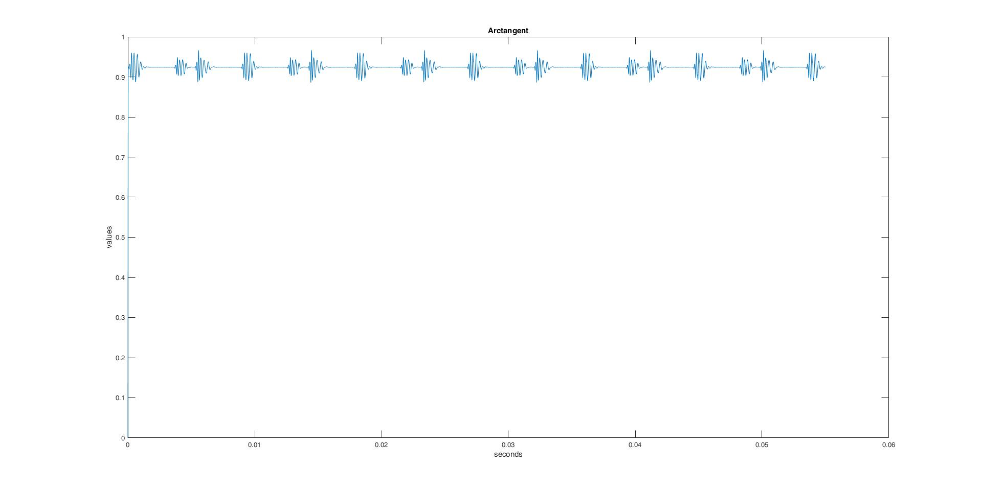
Arctangent

